Slide 1
Gaps and Opportunities in programming RJ in SA
Marion Stevens
Sexual and Reproductive Justice Coalition

Slide 2
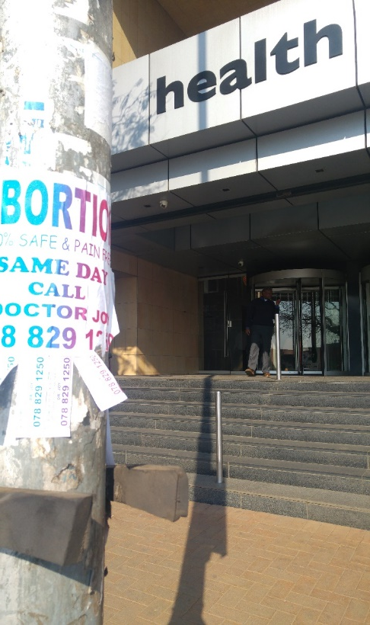
Background: Informed by SRJC activities and collaboration – five focal areas: abortion, contraception, queer health, adolescent SRHR, sex work decrim A number of challenges/misalignments &nd opportunities for improvement

Slide 3
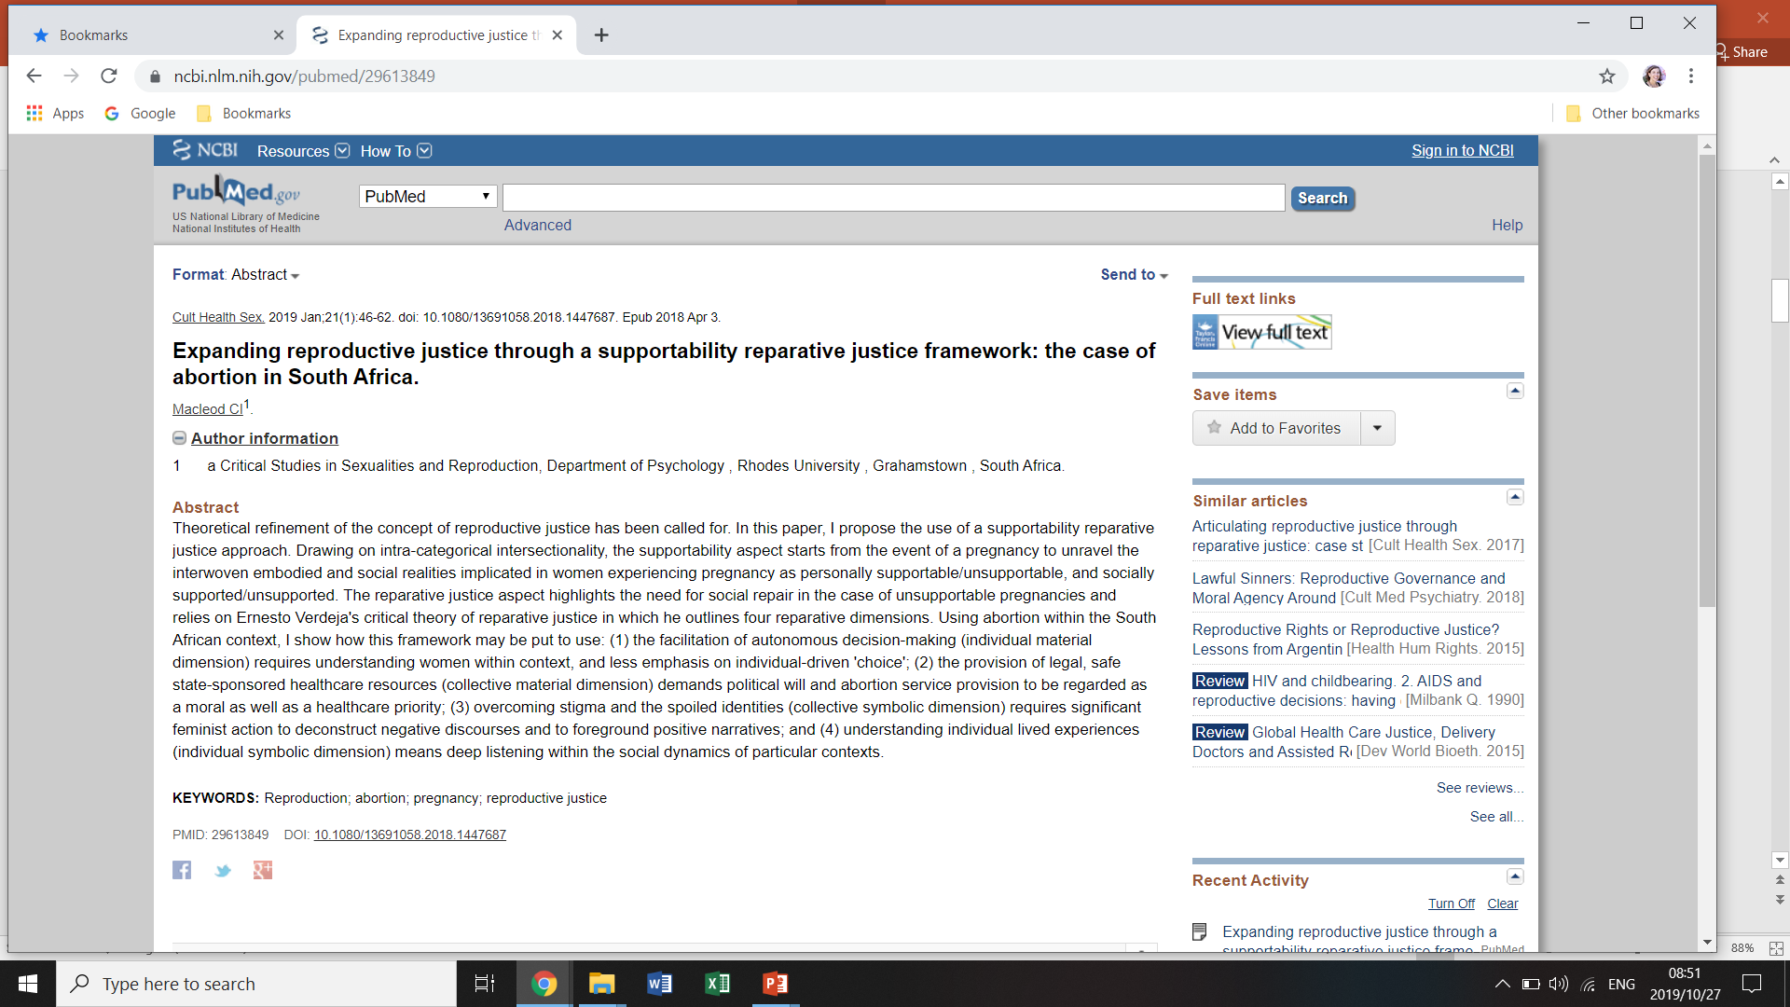
ASRHR, LGBTI and sex worker research
Concept of Supportability
Change from unwanted and unintended pregnancies

Slide 4
Comprehensive Sexuality Education - Life Orientation
Referred to as Life Orientation (LO) compulsory
Five emerging themes
1. Bombards learners with ‘disease, danger and damage’
Negative consequences of sex (pregnancy, HIV) little attention to pleasure.
Told what NOT to do
Linked to abstinence
This does not link to realities of youth sexuality and cultures – sexualities fluid – source of conflict and pleasure
Sex positive view
Attentive to cultural contexts and expressions of sexuality
2. Unknowingly promote rigid versions of gender - some underlie sexual violence
Fixed bodies – men lead in sexuality, women take responsibility – identify as vulnerable and passive. Women police male sexuality at the same time men's desires and needs privileged – contradictions
Disrupt the gender order that privileges male power and desire
Complexity of women’s role in maintaining gender order acknowledged and challenged

Slide 5
3. Disconnection – disengaged/detached attitudes in relation to LO
Non relational style of LO – authoritarian , content often irrelevant in their lives. Content does not echo the complexity of sexualities or behaviours
Repetitive - learn more from peers than class
Young people viewed as asexual
Learner focused initiatives need to be encouraged
LO must provide space for in-depth interactions and discussions
4. Heteronormativity and Homophobia
Culture of heteronormativity – cultures of silence and homophobia
Strong resistance from parents
Teachers lack guidance
Teachers need training in issues related to sexual and gender diversity
Teachers need to be encouraged to reflect on their own beliefs, cultures and biases
5. Teachers underprepared and under supported
Teachers engage in care work – from pregnancy, HIV to violence
Contradictions – person – curriculum and school. Discipline complex
Difficulties ned to e acknowledged and teachers provided with support
Clear protocols concerning reporting sexual violence or other difficulties need to be established and teachers need to be able to debrief
(Policy Brief – April 2016 Catriona McCleod - Critical Studies in Sexualities and Reproductive Research Programme – SRJC

Slide 6
Social inclusion of Gender Diverse persons

Slide 7
Description and methods:
*Qualitative research collating narratives of sex workers
accessing information on sexual and reproductive health
and rights and services and in particular their experiences of accessing contraception and abortion
* N=45 day long participatory body mapping workshops in Cape Town, Durban and Johannesburg. 43 consented to sharing stories
*Ethical approval obtained from the Faculty of Humanities at UCT.
* Analysis was developed from self-reported stories noting emerging themes and narratives recorded. Reflection between facilitators. Reproductive justice framework used.
* Complex listening and story telling, a range of language used. Need for referral to counselling and services. Need for care

Slide 8
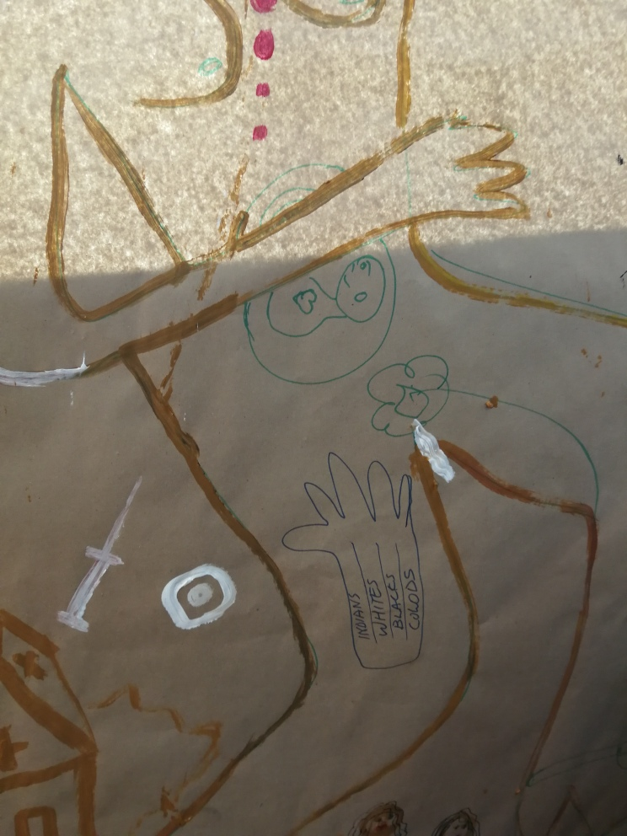
Fertility Planning and HIV
*Most described difficulty in accessing a contraceptive that worked
for themselves personally, a large proportion had used the
injectable contraceptive. (N=21). 2 pregnant whilst using contraception – Implant and ARVs
*Many used condoms with clients if they could access
them and negotiate use. (N=19)
*Some of the participants disclosed being HIV
positive (N=14) and the challenges of fertility planning.
*Most participants described the health services as not
friendly and had narratives of experiencing violations,
including obstetric violence

Slide 9
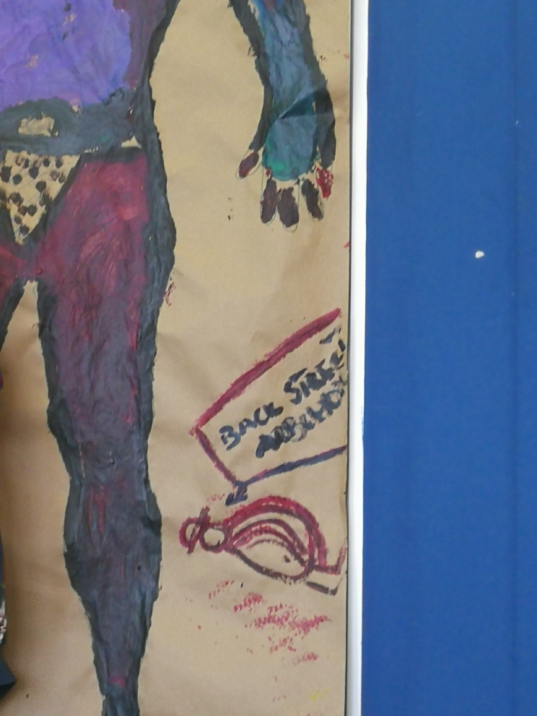
Abortion
*Participants reported having
unsupported pregnancies and had accessed an informal or legal abortion.
*Eight participants described consulting an informal provider outside the health system to access an abortion using an illegal method.
*One described how she had self-induced three abortions on herself using a foleys catheter she had purchased from a pharmacy and using hot water. She induced bleeding and then would go to the hospital
*Most used medial abortion.
*All described the difficulty in access and delays

Slide 10
Conclusions
*Informed by Reproductive Justice perspective
*Need for coordination
*Health, Education, DSD, Higher Edu, Justice - Presidency
*Local engagement, sustainability and capacity – ownership
* Advancing public sector

